Slide 1
DocumentDB

Slide 2
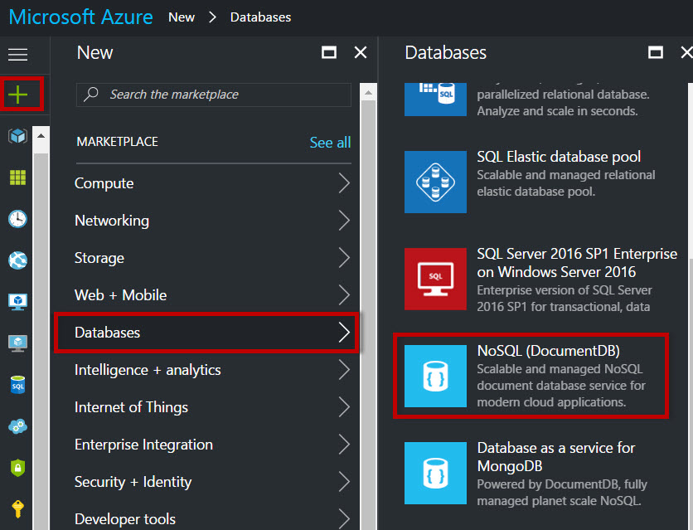
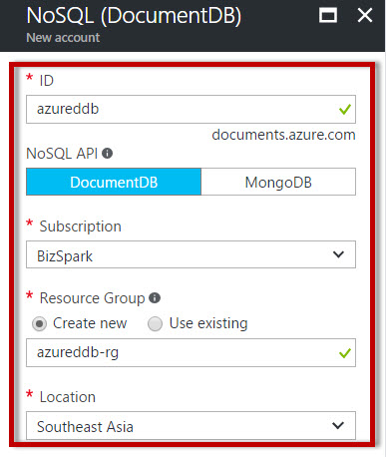

Slide 3
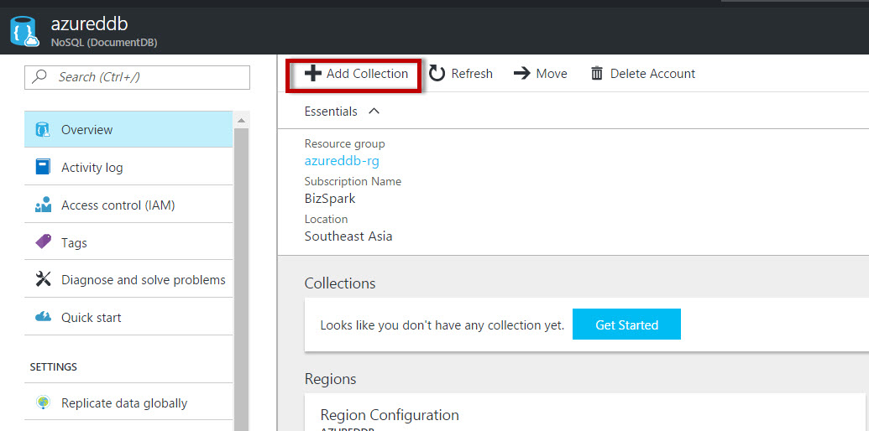
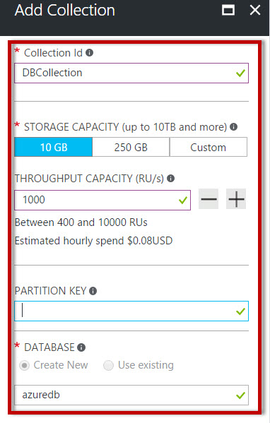

Slide 4
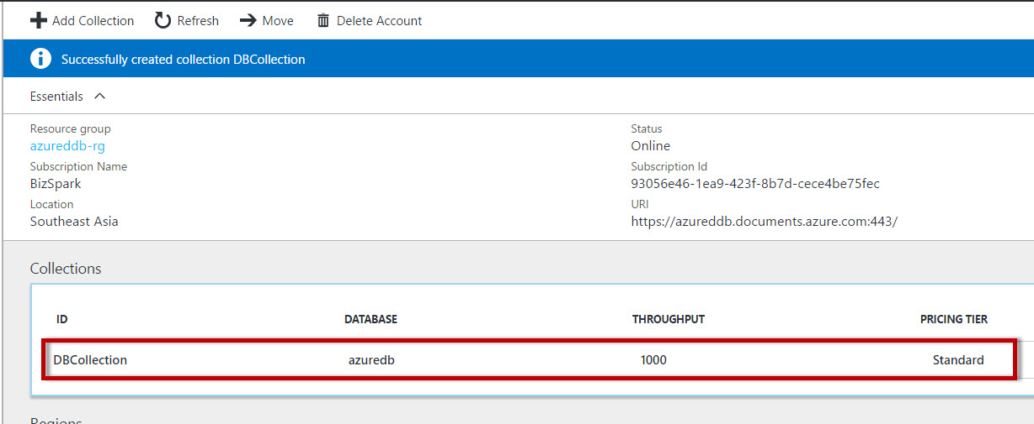

Slide 5
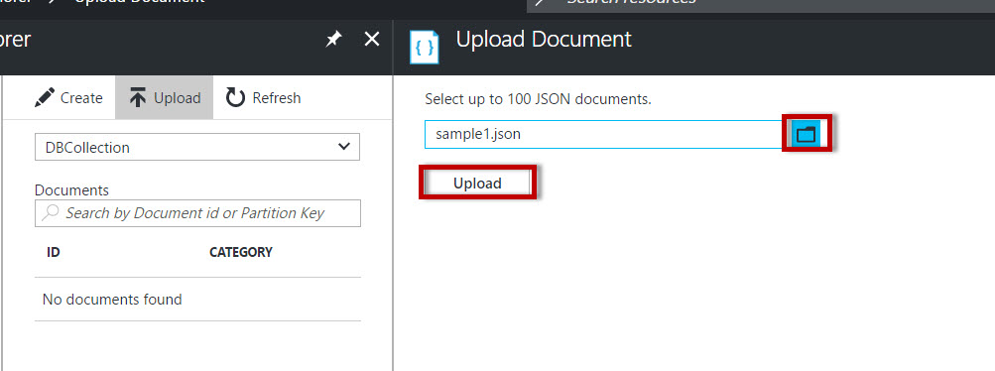
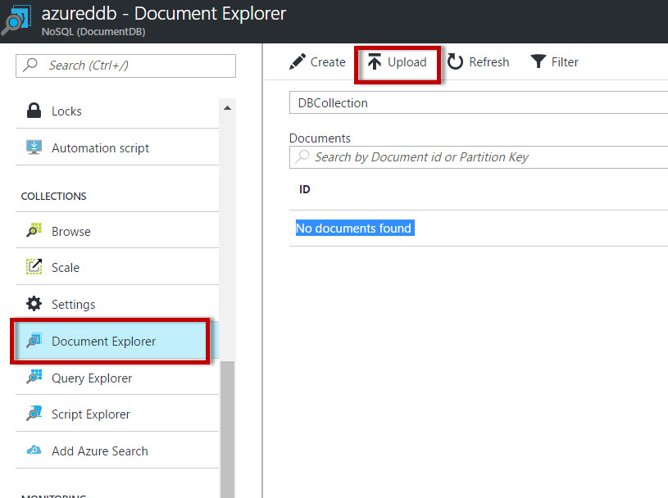

Slide 6
{
"id": "Sample1",
"description": "Make salsa",
"category": "groceries",
"list": [
{
"amount": 1,
"item": "Onion",
"type": "produce"
},
{
"amount": 4,
"item": "Tomato",
"type": "produce"
},
{
"amount": 3,
"item": "Jalepeno",
"type": "produce"
},
{
"amount": 1,
"package": "bunch",
"item": "Cilantro",
"type": "produce"
},
{
"amount": 1,
"item": "Molcajete bowl",
"type": "cookware"
}
]
}

Slide 7
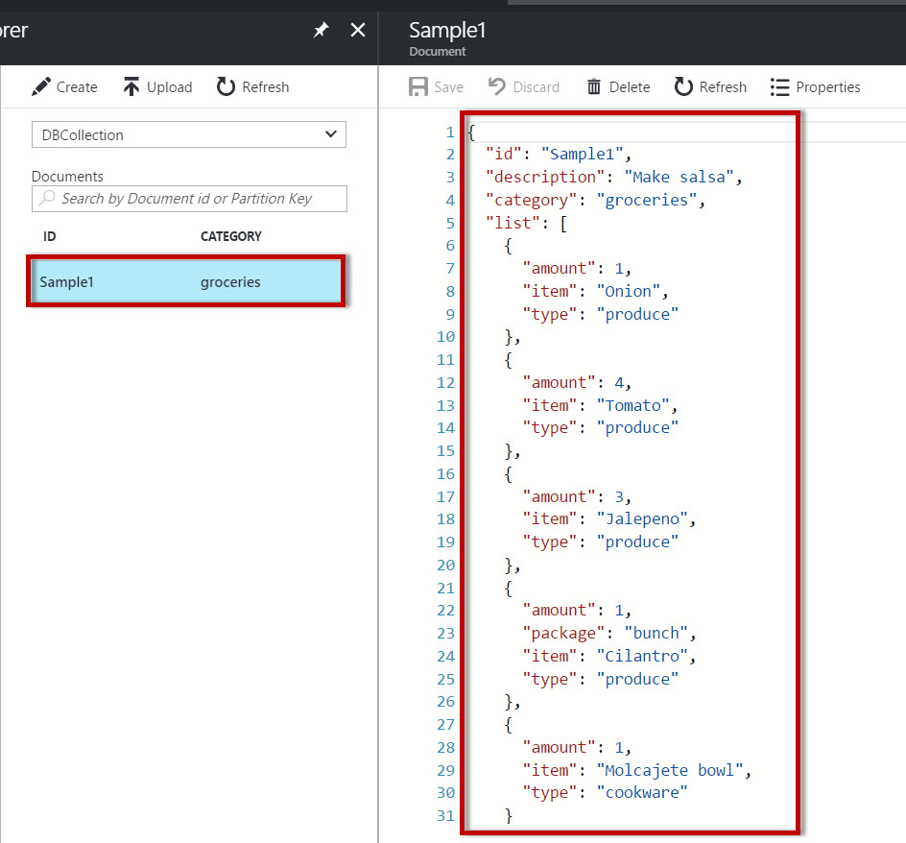

Slide 8
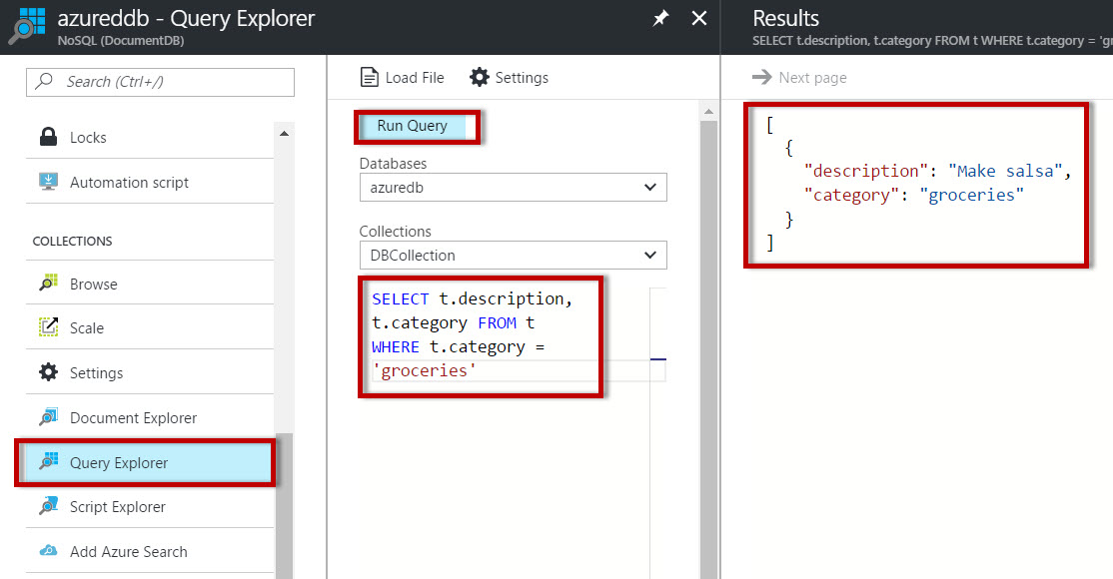
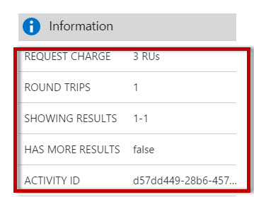

Slide 9
